Slide 1

Technology Trend
Technology
In
Motion
Analysis of Technology in Demand on Demography
Ferdous Haque
IBM Data Analyst Professional Certificate
11-03-2024

Slide 2


OUTLINE
Tech
Executive Summary
Introduction
Methodology
Results
Visualization – Charts
Dashboard
Discussion
Findings & Implications
Conclusion
Appendix

Slide 3


EXECUTIVE SUMMARY
The purpose of this presentation is to highlight both current and future global technology trends based on empirical data collected from Stack Overflow and its sister company, Prosus. This data provides valuable insights into the evolving landscape of technology adoption and innovation.
This entity plays a pivotal role in capturing, sharing and collaborating on knowledge globally an unprecedented scale. Through its extensive data collection and analysis efforts, it has become the largest technology investor worldwide, providing a comprehensive view of technological advancements and market dynamics.
We utilized visualization tools such as IBM Cognos and Google Looker Studio to depict the top ten technological demands across four major areas: computer programming languages, databases, platforms, and web frameworks. These visualizations, which include plots, charts, and spatial data analytics, provide insights into current and future trends in these domains.

Slide 4


INTRODUCTION
We initiated our data exploration by tackling a massive dataset, extracting a sample of over seventy-four thousand respondents from an approximately population of one billion. Our focus group is significantly smaller, as we narrowed down the data to the top ten entries from each major area of the study, as detailed in the Executive Summary. Additionally, a considerable number of the respondents had missing or null values.
A research study from the Harvard Kennedy School of Government demonstrates a triangular relationship among knowledge, technology, and economic growth. It identifies technology as the driving force behind economic growth in different geographical area.
Our visual representation aligned well with this study, illustrating how the current and future technology demand can converge into economic growth within a globally dynamic demographic. Additionally, this can support the study’s hypothesis depicting in visualization.

Slide 5

METHODOLOGY
Our methodology employs a combination of categorical analysis and statistical analysis. Initially, categorical analysis involves organizing technological tools into one of four predefined groups, as detailed in the Executive Summary. This is followed by statistical analysis, which is utilizes frequency distribution to illustrate how frequently each tool was selected by respondents, highlighting their popularity.
Subsequently, we identify top ten tools within each category based on respondents’ choices, using frequency distribution to focus on the tools of interest. Our analysis then examines quantitative measures to identify the key trends in technological demand, providing insights into which tools are gaining popularity. The outcomes are depicted through visualizations such as graphs and charts.

Slide 6

RESULTS
Our raw data has been translated and represented in a visual context using charts, text annotations, spatial maps, and graph. We will analyze these visual elements to extract potential insights for quantitively analysis, as raw data is no longer the primary focus of this analysis.
In the following slides, we have included graphs and dashboards to optimize the visualization of technology trends at a glance, independent of the raw data.
A cursory examination of these visual objects reveals that several cutting-edge technological trends, such as computer programming languages, databases, frameworks, and platforms remain consistent across both current and future time frames. Additionally, the demographic analysis indicates an increase in male representation across all aspects of technology trends spatially.

Slide 7
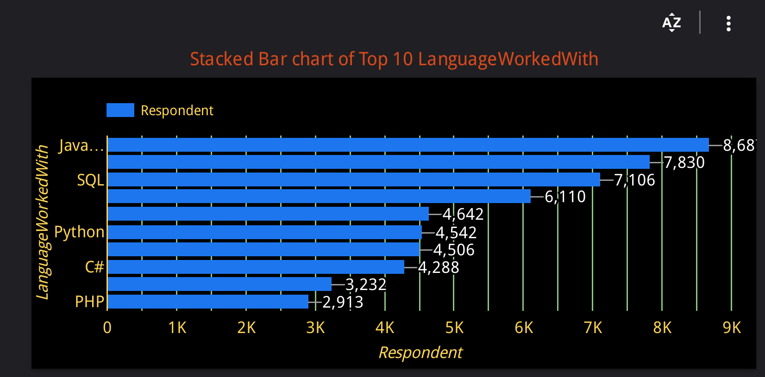
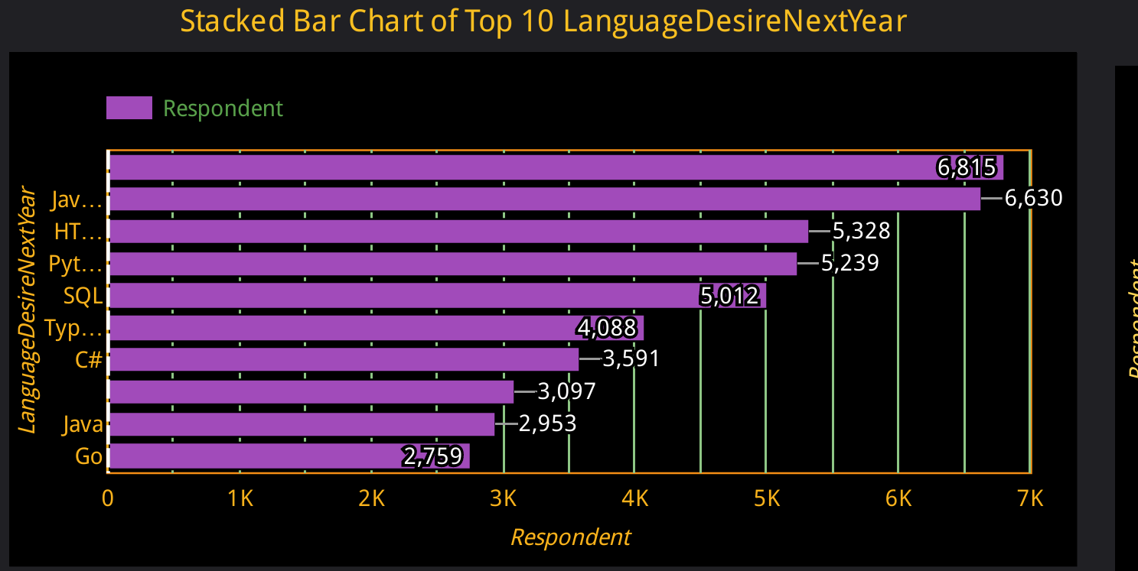
PROGRAMMING LANGUAGE TRENDS
Current Year
Next Year
<Bar chart of top 10 programming languages for the current year goes here.>
< Bar chart of top 10 programming languages for the next year goes here.>

Slide 8
PROGRAMMING LANGUAGE TRENDS - FINDINGS & IMPLICATIONS
Findings
Current trend in programming language shows Java Script at the top followed by HTML/CSS, SQL Bash/Shell/ PowerShell and Python.
This ranking is expected to change slightly next year with Java Script and HTML/CSS maintaining their top positions despite a significant drop in popularity.
Notably, Python is the only language that has seen a dramatic increase in popularity.
Implications
We observed a downturn in Java Script’s popularity by approximately 24%, followed by nearly 32% decrease for HTML/CSS.
Python’s demand increased by about 15% during the same period, indicating growing interest and potential future dominance.
Bash/Shell/Power Shell has completely dropped from the ranking, suggesting a shift in preference away from these tools.

Slide 9
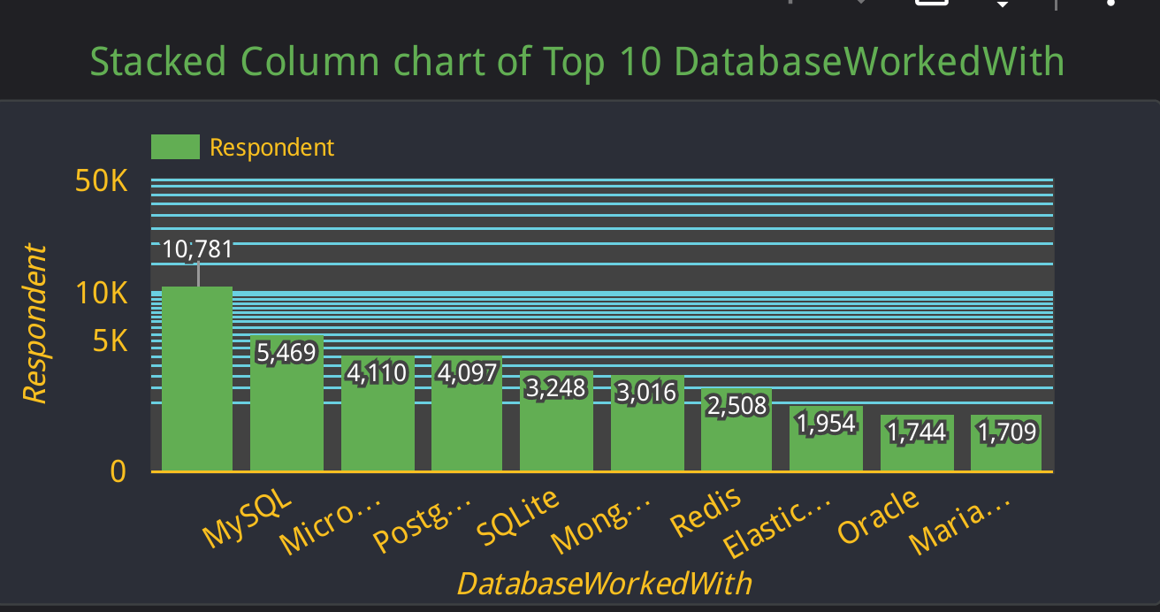
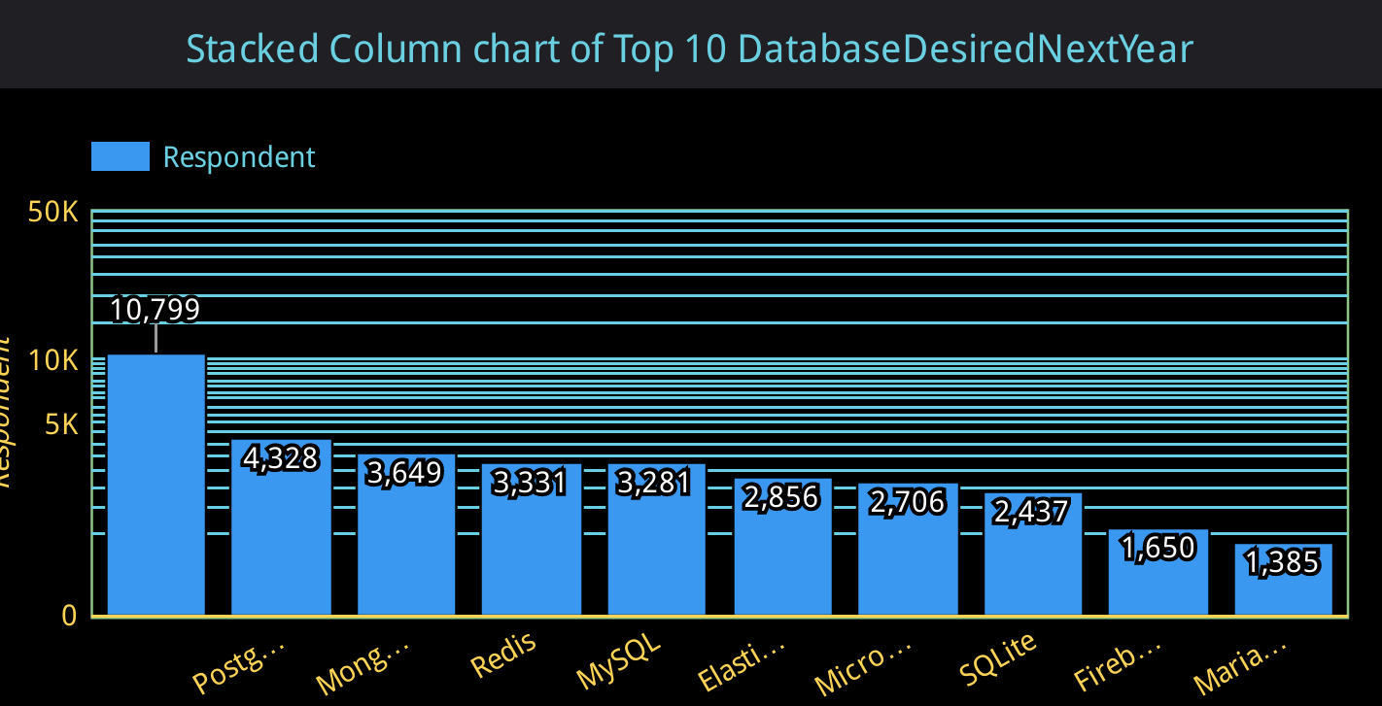
DATABASE TRENDS
Current Year
Next Year
< Bar chart of top 10 databases for the current year goes here >
< Bar chart of top 10 databases for the next year goes here.>

Slide 10
DATABASE TRENDS - FINDINGS & IMPLICATIONS
Findings
The current trend in database shows MySQL with the highest popularity followed by Microsoft SQL Server, PostgreSQL, SQLite, and MongoDB as the top five databases.
With a significant 40% drop in MySQL’s popularity, PostgreSQL is projected to rise to the top with a modest 5% increase next year. The new ranking will feature MongoDB with a 21% increase, Redis with nearly 33% increase, and MySQL in fourth place despite the drop.
Microsoft SQL Server and SQLite are expected to experience popularity drops of 34/% and 25%, respectively.
Implications
Despite some sharp declines in database rankings next year, it is crucial to note that a significant portion of respondents in this category had null values. This, combined with a smaller focus group, may have led to unusual outcomes.
Consequently, PostgreSQL is expected to take the top spot with only 5% rise in popularity. Additionally, SQLite is nearly disappearing from the ranking.

Slide 11

DASHBOARD
<The GitHub link of the Cognos/Looker Studio dashboard goes here.>

Slide 12
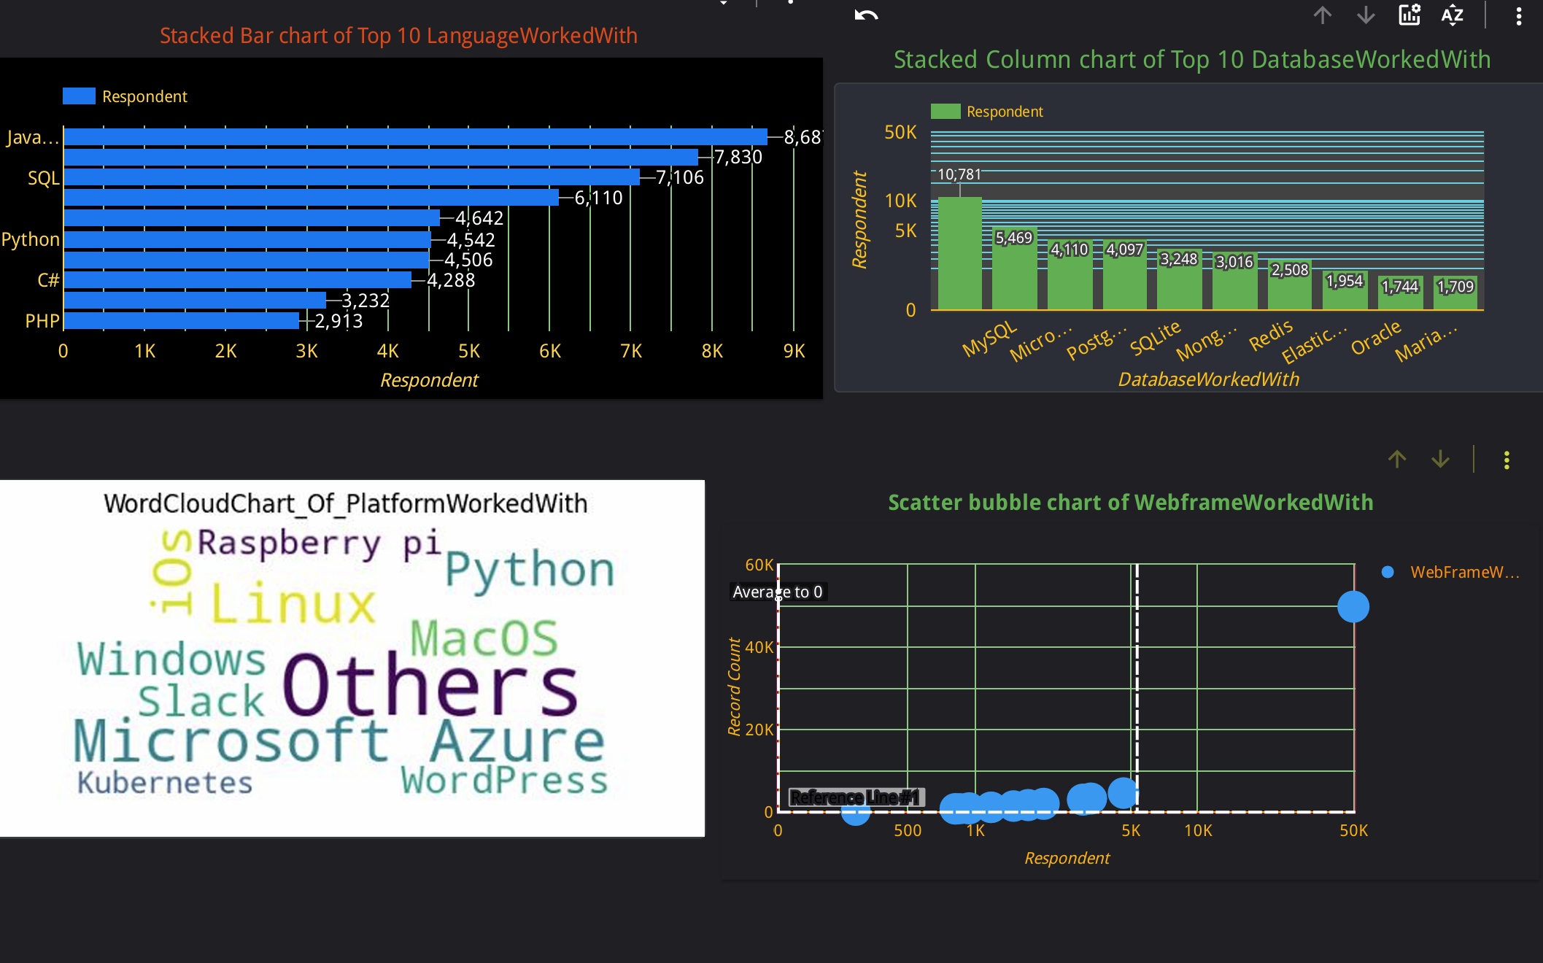
DASHBOARD TAB 1
Screenshot of dashboard tab 1 goes here

Slide 13
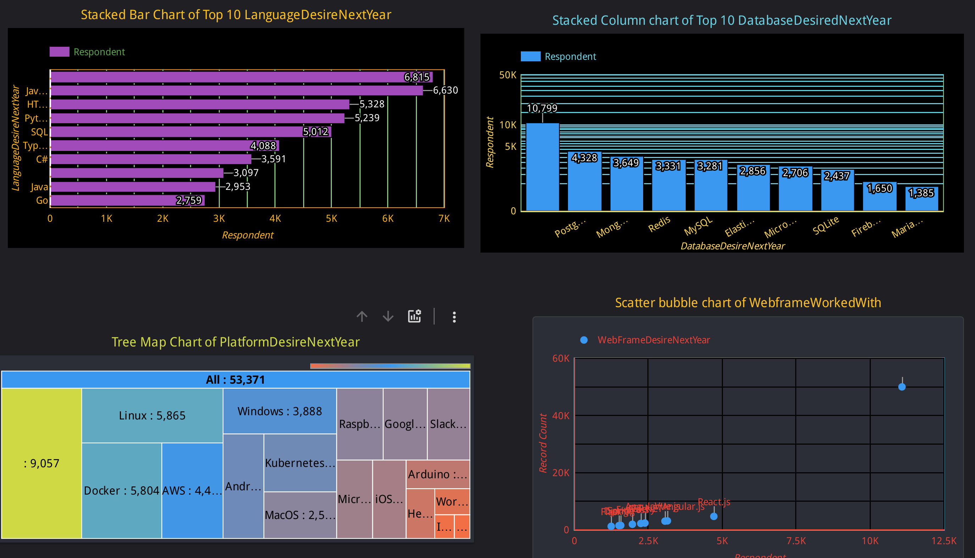
DASHBOARD TAB 2
Screenshot of dashboard tab 2 goes here

Slide 14
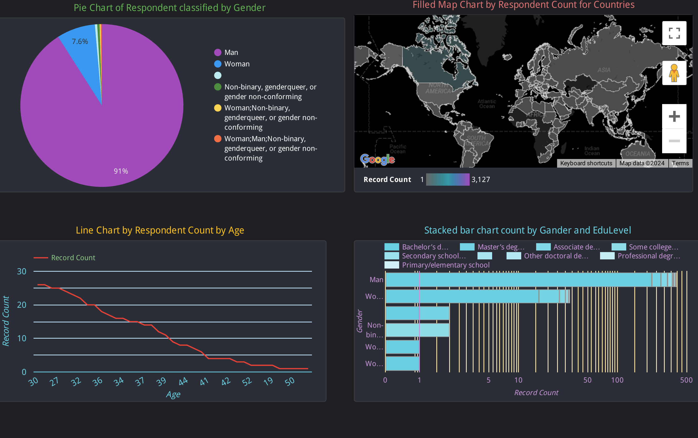
DASHBOARD TAB 3
Screenshot of dashboard tab 3 goes here

Slide 15

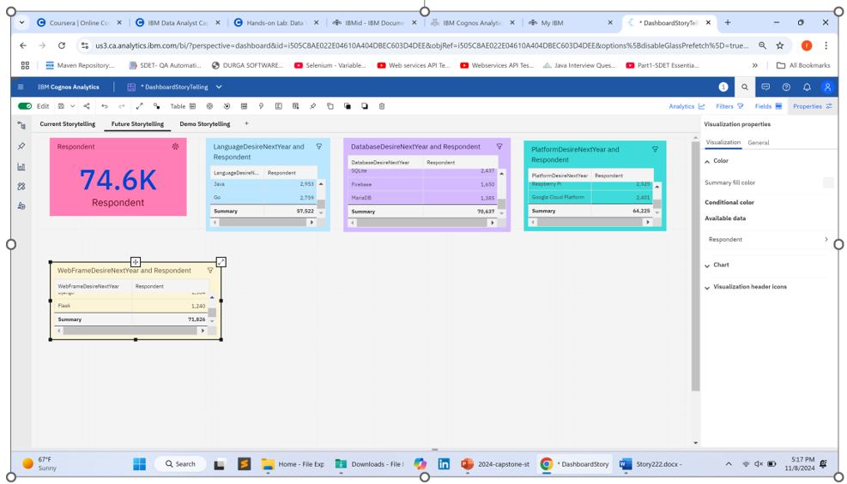
DISCUSSION
We inserted the same dataset into both IBM Cognos and Google Looker Studio, and unsurprisingly, their visual portrayals are quite similar.
Both tools share common features for creating graphical presentations, such as functions, properties, dimensions, metrics, colors, sizes, and styles. For instance, the drag-and-drop feature allows users to dynamically adjust visual properties instantly.
These features enhance the visual representation, making it easier to understand and extract meaningful insights from the data and demographics, which are crucial for informed decision-making.
Additionally, a high-level overview of the visualization suggests that the technology and tools remain consistent and reliable for practical purposes over time.

Slide 16
OVERALL FINDINGS & IMPLICATIONS
Findings
The trend in the popularity of technological tools among respondents remains largely constant across demographic dimensions, including gender and age.
If the sample size for the database group were equal to that of the programming language group, the outcomes might have been more comparable, highlighting the importance of balanced sampling.
Notably, Python is the only technology that has shown a significant increase in popularity within our focused time frame. Consequently, Python is expected to become a dominant technological demand in the near future, maintaining consistency across spatial demographics, gender, and age dimensions.
Implications
Based on our qualitative analysis of interest in the top ten technologies, we have categorized them into four broad groups: Java Script, Python, Html/CSS, and SQL. These technologies form a cohesive group alongside databases like MySQL, PostgreSQL, Redis, MongoDB, and SQLite.
Recognizing these specific tools allows us to relate them to Platforms and Web Frameworks. For instance, SQL and Python are considered Domain-Specific Language (DSL), with Python notably serving dual roles as both a general purpose and domain language. Known for its simplicity and versatility, Python is widely used across various fields, including web development, data science, and machine learning. Its syntax is highly specialized and optimized for specific tasks, supported by a vast library ecosystem and data structure algorithms(DSA), enhancing the application development experience.
The benefits of employing Python in application development and programming extensive, and its adoption is expected to continue growing.

Slide 17

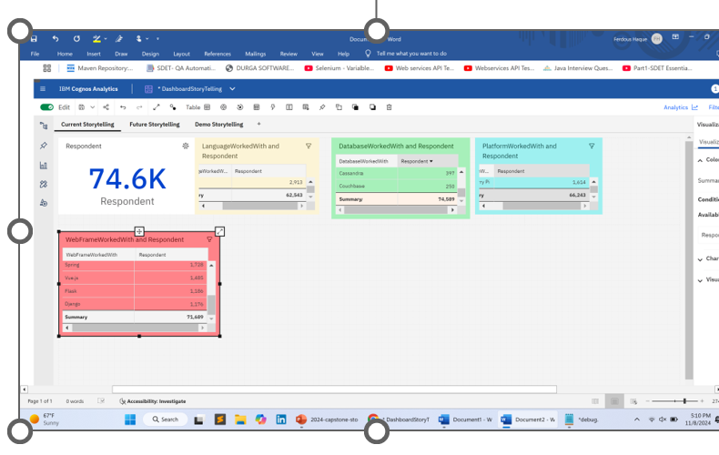
CONCLUSION
In conclusion, the four leading technology trends discussed in this presentation serve as foundational and cutting-edge tools essential for advancing the modern world. While our presentation was not explicitly based on this premise, it aligns with the assertion that knowledge and technology drive economic growth.
These standout technologies in visualization can support hypotheses exploring their benefits for policy and decision making purposes.

Slide 18

APPENDIX
To the https://rcc.harvard.edu/
Research/Study Group
knowledge-technology-and-complexity-economic-growth
https://www.mckinsey.com
Capabilities
Digital/Our-Insights
The top trends in tech 2024
https://www.mckinsey.com
Capabilities
Digital/Our-Insights
The top trends in tech 2024

Slide 19
JOB POSTINGS
In Module 1 you have collected the job posting data using Job API in a file named “job-postings.xlsx”. Present that data using a bar chart here. Order the bar chart in the descending order of the number of job postings.

Slide 20
POPULAR LANGUAGES
In Module 1 you have collected the job postings data using web scraping in a file named “popular-languages.csv”. Present that data using a bar chart here. Order the bar chart in the descending order of salary.

